Slide 1
INT306 Database Management System
Lecture 0

Slide 2
‘ Let’s move toward the better way to store and manage the data’

Slide 3
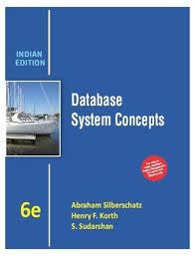

Course Details
L T P – 0 0 5
Text Book –
DATABASE SYSTEM CONCEPTS by HENRY F. KORTH, ABRAHAM SILBERSCHATZ, S. SUDARSHAN, TATA MCGRAW - HILL EDUCATION, 6th Edition, (2010)
Reference Book –
SIMPLIFIED APPROACH TO DBMS by PRATEEK BHATIA AND GURVINDER SINGH,KALYANI PUBLISHERS

Slide 4
Course Assessment Model
>=90% -- 5 marks
>=85% and <90% -- 4 marks
>=80% and <85% -- 3 marks
>=75% and <80% -- 2 marks
Marks break up
Attendance 5
CA(2 best out of 3) 20
MTE 25
ETE 50
Total 100
Each CA would be of 30 marks

Slide 5
COURSE OUTCOMES
Develop skills and understanding in the database design and make use of database management systems for applications
Develop understanding about relational algebra, relational model and SQL for implementing and maintaining databases
Develop understanding about the different issues involved in the design and implementation of a database system
Develop skills and understanding about the real time transaction management systems and the concurrency control techniques
Compose programming constructs such as functions, stored procedures and triggers that can be shared by multiple forms, reports and data management applications

Slide 6
UNIT-1 Introduction to Database
Purpose of database systems
Components of DBMS
Applications of DBMS
Three tier DBMS architecture
Data independence
Database Schema, instance
Data modeling
Entity Relationship model
Relational model

Slide 7
UNIT-II Relational Query Languages
SQL Statements
Relational Algebra
Data Definition Language
Data Manipulation Language
Data Control Language
Transaction Control Language
Integrity Constraints
Database Keys

Slide 8
UNIT-III Relational Database Design
Data integrity rules,
Functional dependency
Need of normalization,
Types of Normalization
Pitfalls in relational database design

Slide 9
UNIT-IV
Transaction system concepts,
Desirable properties of transactions
Schedules,
Serializability of schedules
Concurrency control
Recoverability

Slide 10
UNIT-V Programming Constructs in Database
Flow Control Statements
Functions and stored procedures
Cursors
Triggers
Exceptional Handling

Slide 11
UNIT-VI File Organization and Trends in Databases
DBMS file Organization
Type of file organizations
Indexing
Hashing
Big Data and NoSQL system

Slide 12
Questions…?
The three BURNING questions in mind…
Why are we learning databases, Is Excel not enough
What operations we can perform and purpose it would solve
What will be the course outcome?

Slide 13
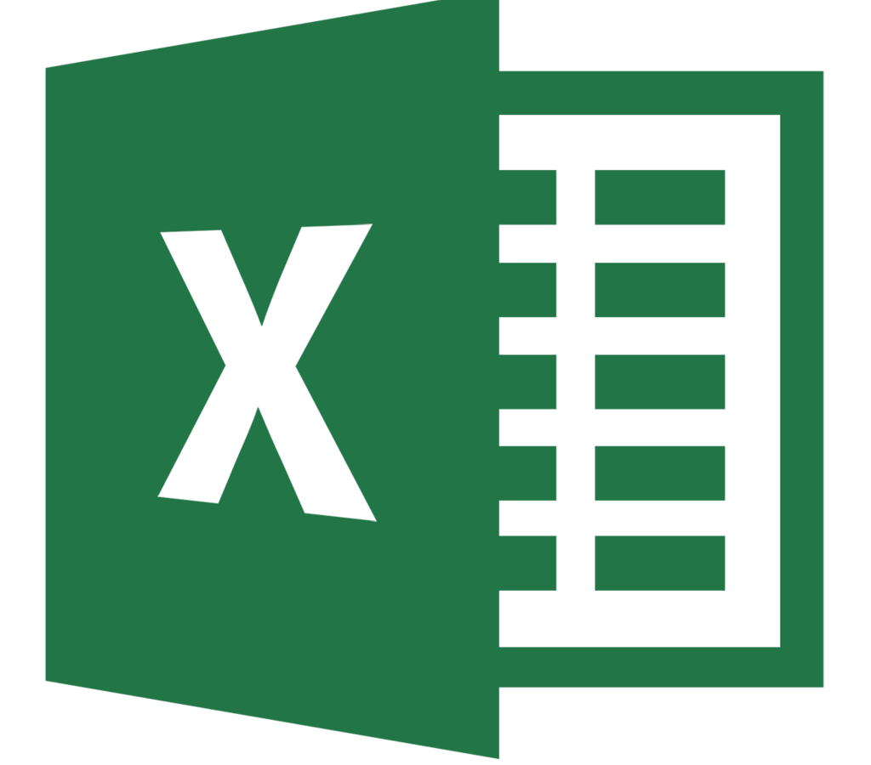
Is Excel a database???

Slide 14

Definitely Not!!!
A spreadsheet is an application for tabulating data while a database is where data is stored so that it can be retrieved by users
The amount of data that is usually stored in a database is way more than what is contained in a spreadsheet
A spreadsheet is edited directly by people while a database is accessed by applications that enter and modify data
A spreadsheet is usually used for presentations and paperwork while databases are commonly used in cases where a lot of data needs to stored

Slide 15
Advantages of DBMS
Controlling Redundancy
Integrity can be enforced
Inconsistency can be avoided
Data can be shared
Restricting unauthorized access
Providing Backup and recovery
Concurrency control

Slide 16
Disadvantages of DBMS
Complexity
Size
Performance
Cost of DBMS
Additional hardware cost
Cost of conversion

Slide 17
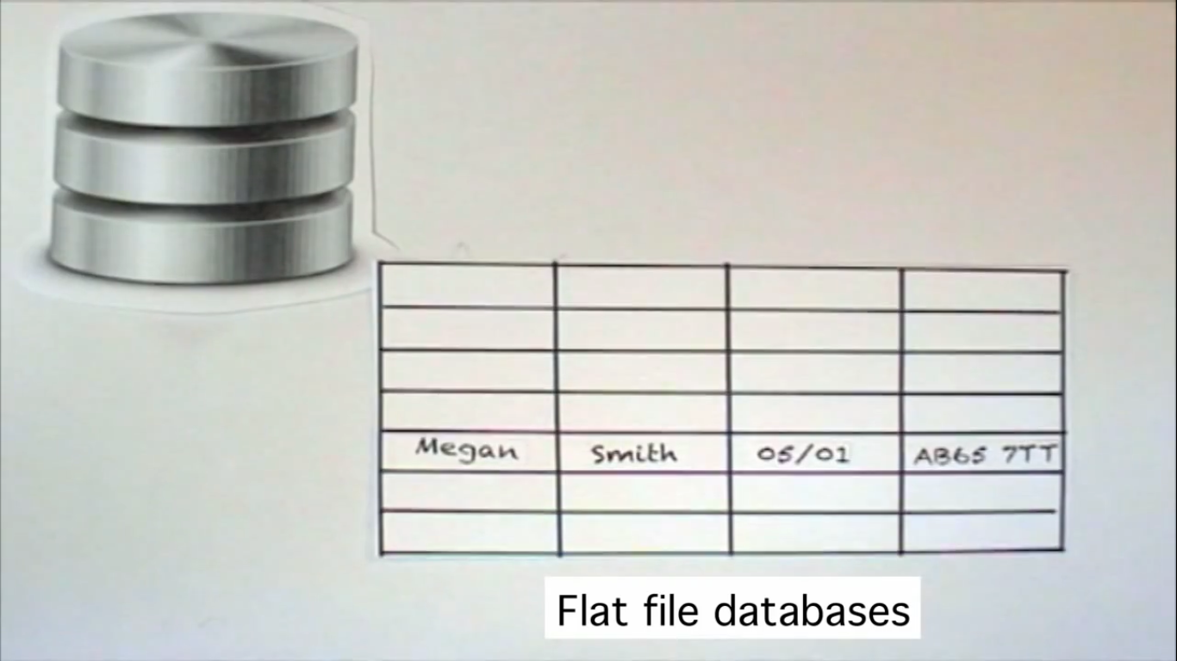
Structure of Relational Databases
Notes:
Simple Databases : Flat File Databases which stores data in the form of rows and columns

Slide 18
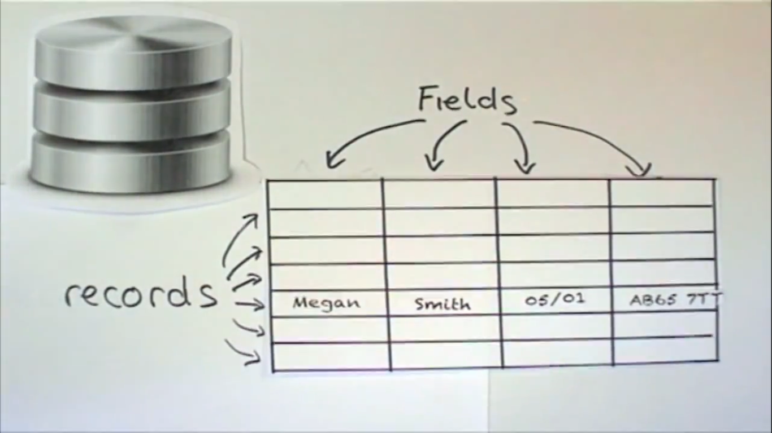
Managed in the form of Rows and Columns

Slide 19
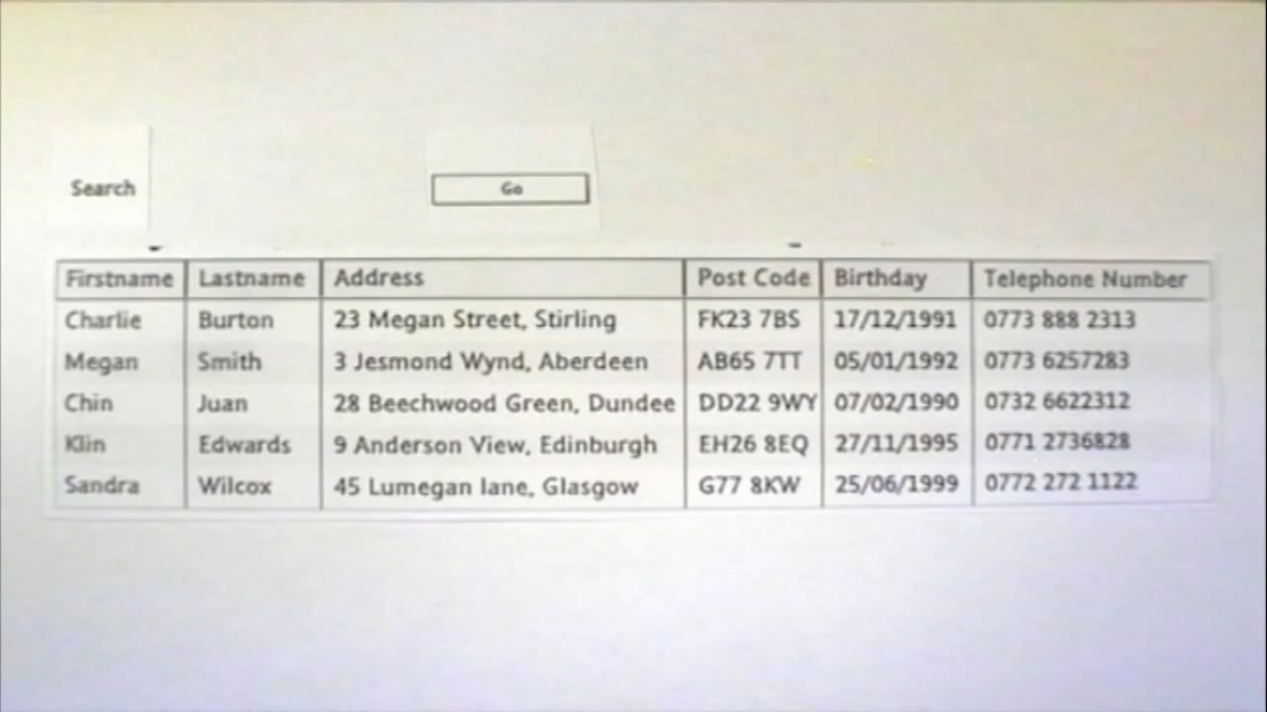
Can perform various operations!!!
Notes:
Can perform various operations: Lets search for Megan.
Can make the search more accurate by selecting the fields he wants.

Slide 20
What you would learn ☺
Develop skills and understanding in the database design and make use of database management systems for applications
Develop understanding about relational algebra, relational model and SQL for implementing and maintaining databases
Develop skills and understanding about the real – time transaction management systems and the concurrency control techniques
Understand the access structures needed to speed up the retrieval of records in response to certain search conditions
Extend the understanding and implementation of the database technology in the distributed environment

Slide 21
Syllabus
Refer this link to download the syllabus:
https://ums.lpu.in/LpuUms/frmacademicsyllabusreport.aspx

Slide 22
Let's Begin

Slide 23
Basic terms:
Data

Slide 24
Basic terms:
2. Database

Slide 25
Basic terms:
3. Information

Slide 26
Basic terms:
4. DBMS

Slide 27
Basic terms:
4. DBMS
5. RDBMS

Slide 28
Basic terms:

Slide 29
Basic terms:

Slide 30
Basic terms:

Slide 31
Basic terms:

Slide 32
Basic terms:

Slide 33
Basic terms:

